Slide 1
I. Bohr Model of Atom
Chapter 5: Electron Configurations

Slide 2
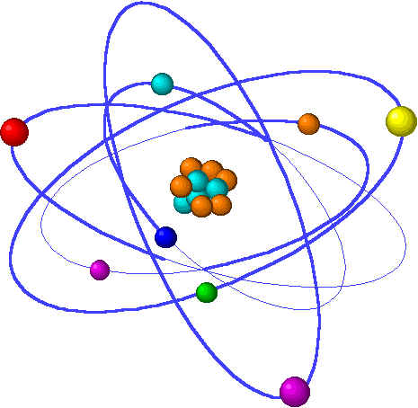
1800’s: Electrons were thought of as particles; light was thought of as waves. Experimental observations can support both these theories.
Early 1900’s: New experiments showed that electrons have some wave-like properties and light has some particle-like properties. These discoveries led to the idea that both electrons and light have a dual wave-particle nature. (This was the beginning of quantum physics.)

Slide 3
Prisms
A prism can be used to “spread out” the wavelengths of light.

Slide 4
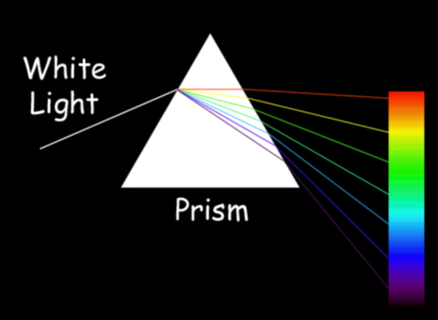

Slide 5
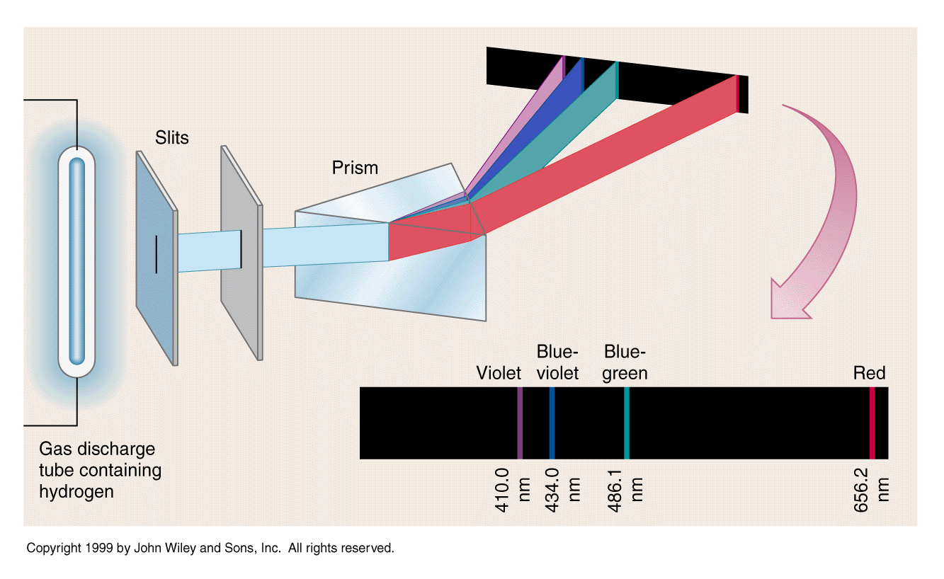
Line Spectra
1. Physics 2000 – Quantum Atom - Line Spectra
2. Line Spectra Animation

Slide 6
Line Spectra (bright-line spectra, atomic emission spectra)
Line Spectra ( or bright-line spectra) – these lines of color are produced when the light from an element is passed through a prism.
Each element produces a characteristic set of lines called the line spectrum of the element. Elements can be identified by their line spectrum.
Each line in a line spectrum represents a particular wavelength and frequency of light given off. You can calculate the energy of the photons of light using E=hν
Bohr used the line spectrum of hydrogen to devise his model of the atom.

Slide 7
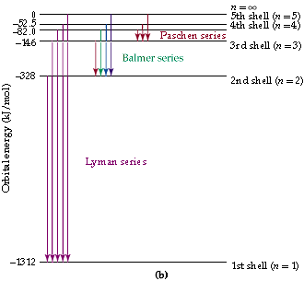

Slide 8
In the Bohr model of the atom, electrons
were found in orbits.
Orbits – the specific circular paths an
Electron can follow around the nucleus.
When atoms absorb energy, electrons jump to higher energy orbits. Then the electrons fall back down and give off the energy as light/

Slide 9
Ground State – when electrons are in
the lowest possible energy level.
Excited State – when electrons are in
Higher energy levels than the
Ground state.

Slide 10
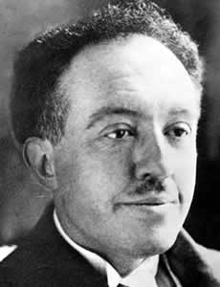
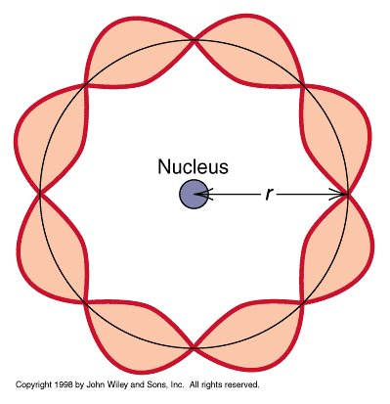
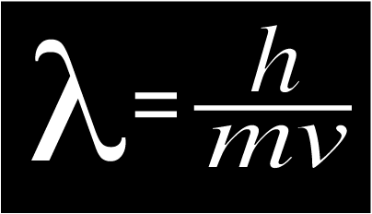
II. Quantum Model of Atom
Quantum Mechanics
(1924) Louis de Broglie says if light has a dual wave-particle nature, then matter (electrons) could also have a dual wave-particle nature.

Slide 11
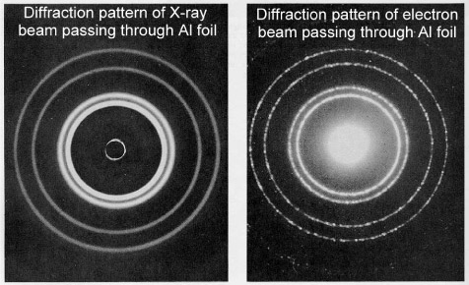
Experiments showed that electrons display the wave properties of diffraction and interference.
Electron Interference Animation(Web)
Drive
Notes:
n

Slide 12
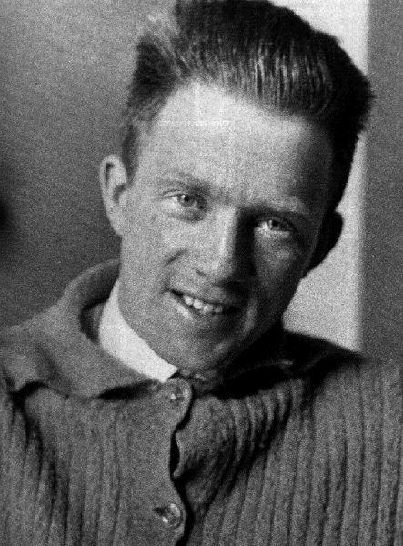
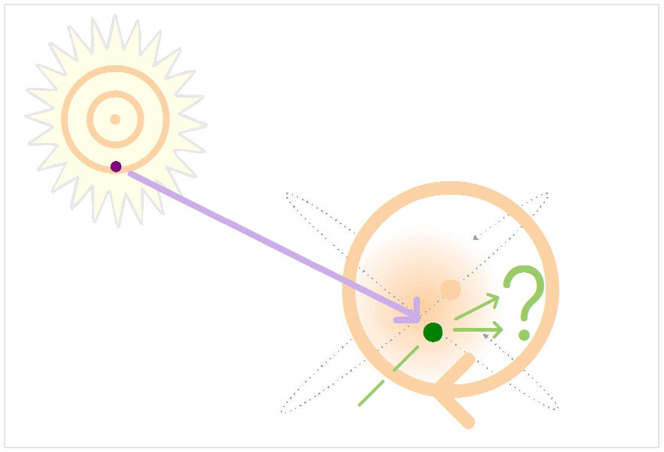
B. Heisenberg Uncertainty Principle
It is impossible to know exactly both the location and velocity of an electron at the same time.

Slide 13
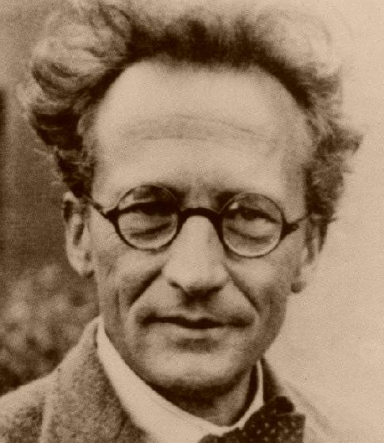
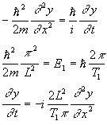
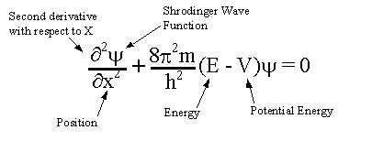
C. Schrodinger Wave Equation
Describes the probability of where an electron can be found. Schrodinger’s equation works for all atoms.
D. Quantum theory – describes mathematically the wave properties of electrons. In the quantum model of the
atom, electrons are found in orbitals, not specific orbits.

Slide 14
In the Quantum model, electrons are found in Orbitals
Orbital – the three dimensional area where an electron can be found.
Quantum numbers – tell you the “address” of orbitals and electrons.

Slide 15
Electrons fill lowest energy orbitals first.
Each orbital can hold 2 electrons.

Slide 16
Principle Quantum Number (n) – tells you what shell (main energy level) an orbital is in.
n=6
n=5
n=4
n=3
Energy
n=2
n = 1

Slide 17
Azimuthal Quantum number – tells you the shape (what sublevel) the orbital is in.
The sublevels are: s, p, d, and f in order of increasing energy.

Slide 18
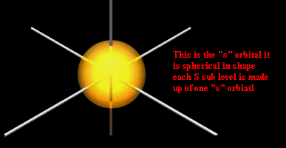
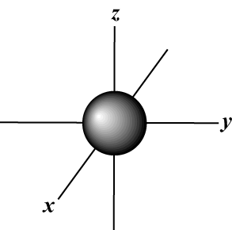
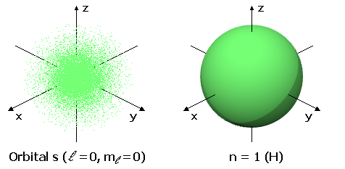
s orbital
One s orbital per shell

Slide 19
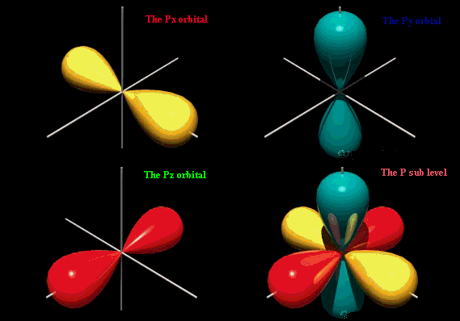
p orbitals
Three p orbitals per shell

Slide 20
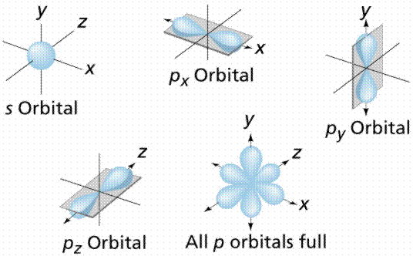
p orbitals first appear in the 2nd shell

Slide 21
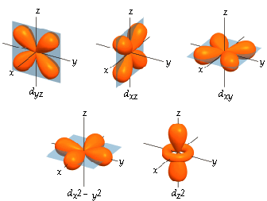
d orbitals
Five d orbitals per shell

Slide 22
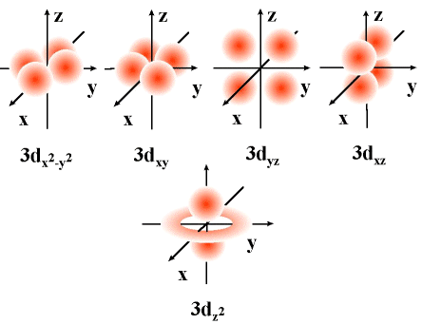
d orbitals 1st appear in the 3rd shell

Slide 23
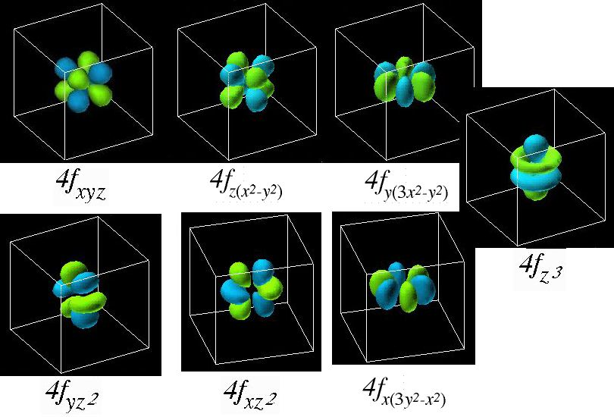
f orbitals
Seven f orbitals per shell
f orbitals 1st appear in the 4th shell

